Slide 1
A WorldFixing Primer: I
Low Hanging Fruit

Slide 2
Low Hanging Fruit
Primer I Goals:
  A Simple Project to reduce Global Warming
  Guaranteed to Work
  Sequester CO2 (GHG’s)
  Easy To Understand
  Easy to Implement
  WorldFixing Solution

Slide 3
Global Warming (Climate Change)
What is it?
  The Atmosphere has too much CO2 (Green-House Gases)
  WE (Humanity) did this, over the past 100 years or so
  Industry and Transportation are the primary culprits
  The Sun is heating up the Planet due to these GHG’s trapping heat in the Atmosphere

Slide 4
Why Didn’t They Tell Us?
They Did:
  Warnings to Humanity began with B. Fuller in 1969
  “Limits To Growth” (First Warning to Humanity)
  Updated “Limits to Growth” (Second Warning)
  For now 50 years, we (Humanity) have failed to heed the Warnings
    Our strategy continues: “Do Nothing” and Hope for the Best!

Slide 5
Technology Solutions Proposed
A plethora of Space Mirrors, to reflect the Sunlight
Dump chemicals in the Ocean and see if it Helps (already done)
Generate Artificial Clouds over the Ocean to help Lower the Temperature
Create Artificial Volcanoes that spews a cloud of ash(Chemicals) to cover the Sun’s rays
Use a Credit system to let CO2 Producers offset with Low-polluters
Other untested, untried, unproven Experiments on our HOME

Slide 6
Primer I Solution
Simple, not Complex
Easy to Understand
Guaranteed to Work
Easy to Implement (No Technology to fail or produce offsetting unexpected Side Effects)
A Regional Solution (all areas, all people)
Profitless with Shared responsibility

Slide 7
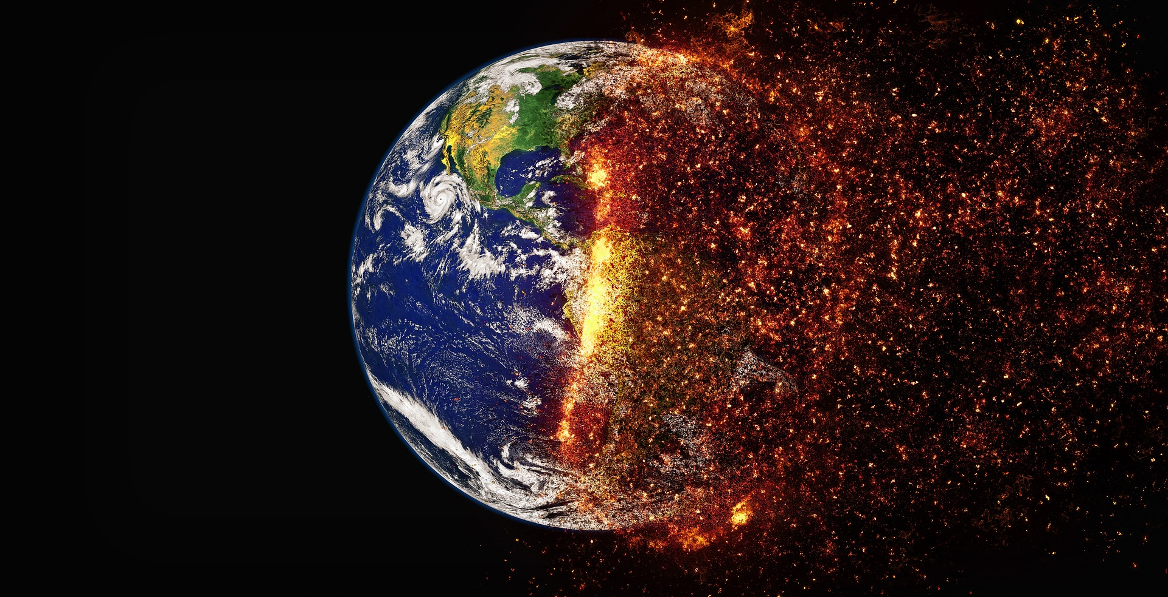
Time To Take ACTION
(Before it’s too Late)

Slide 8
A Simple, Effective Solution
Plant Trees across the Planet

Slide 9
Project Details
Plant roughly 50 billion trees for each of 10 Years, for a total addition of 500 billion trees.
Countries with insufficient land to offset their CO2 production will assist “Tree Planting” in countries with excess land.
Planting density is 3 m x 3 m (10’ x 10’) wherever and whenever possible.
Simple, Easy, Guaranteed to work (with NO side effects)
Inclusive, everyone benefits: the Poor, the Rich and the Inbetweens (Not Rich, Not Poor)

Slide 10
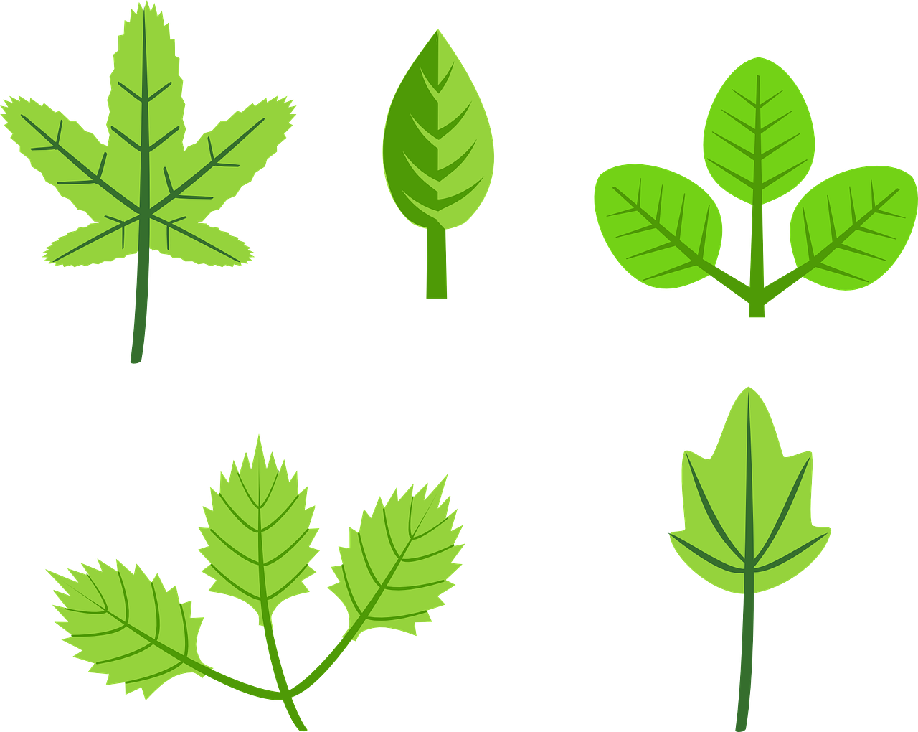
Benefits of Planting Trees
CO2 Removal, Shade, Natural Cooling, Air cleaning, Soil Retention, Oxygen production, Healthier world climate, less Energy needed for cooling, useful Raw Materials (lumber, furniture…)...

Slide 11
Preparation
Research tree species for best native, fast growth, high CO2 sequestration rate, longevity, resistant to pests, drought resistance where necessary
Seeds to produce Seedlings for planting by location
Project Promotion
Workload estimates
Tracking system
Logistics
Distribution
Labour allocations

Slide 12
Project Validation
Calculate exact figures(number and type of trees by country) to reduce CO2 emissions based on IPCC Oct 8, 2018 Report
    45% CO2 reduction (from 2010 base) by 2030, and a further 55% CO2 reduction to Zero emissions by 2050.
Endorse and support Project (Scientists, Engineers, Technologists)

Slide 13
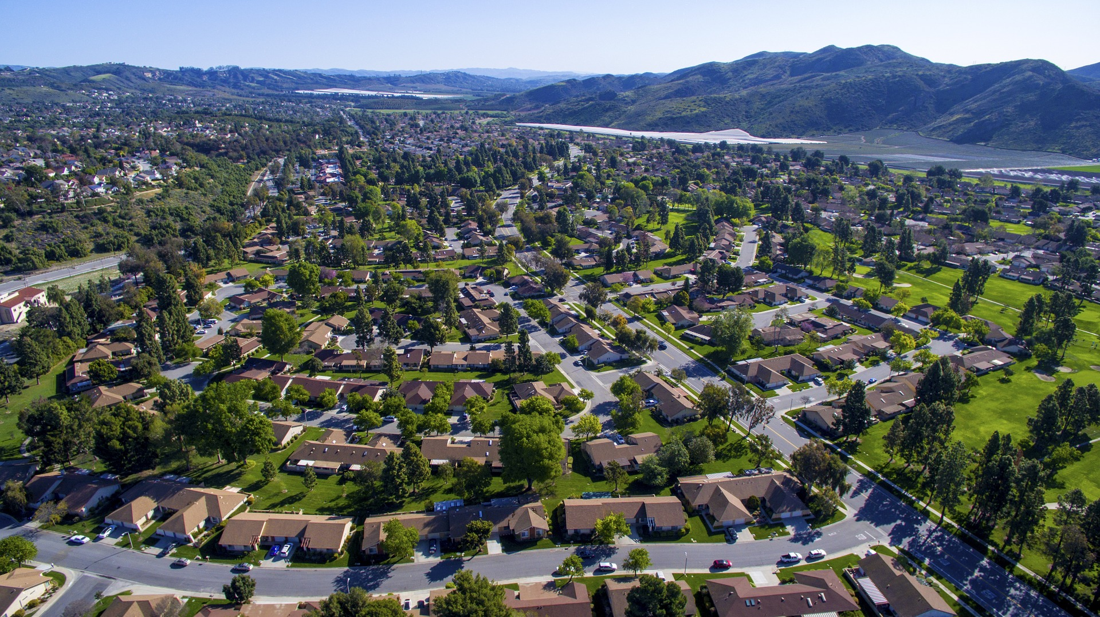
Areas for Tree Planting
The World
By Country
By City
By Town
Rural – Farms, pasture, reforest, cleared land
By Village or Hamlet

Slide 14
Who can Contribute?
Paid Labour
Work teams from those behind bars
Military by country
Volunteers
  Homes, Farms, unemployed
Businesses
Governments at all levels
Individuals
Financial contributions
“Time” to assist this project

Slide 15
Areas (contribution, learn more)
Promotion
Seeds
Research
Reading (“180 Degree Change” - coming soon
WorldFixing
Give the project your “YES” vote.

